Slide 1
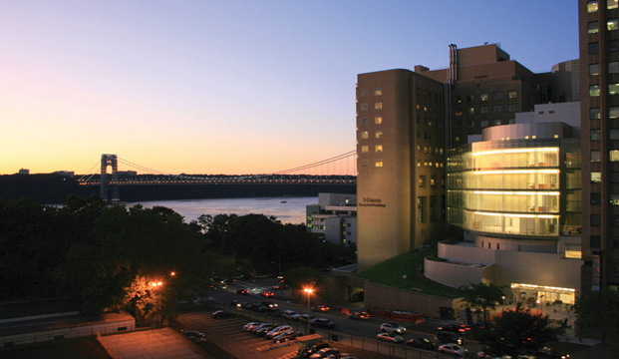
LIVING WITH ADVANCED HEART FAILURE
Melana Yuzefpolskaya, MD
  Assistant Professor of Medicine at CUMC
  Associate Director, Mechanical Circulatory Support
  Division of Cardiology
  Columbia University College of Physicians and Surgeons

Slide 2
#1 Understand Advanced Heart Failure
#2 Identify Your Needs
#3 Explore Treatment Options

Slide 3

23,000,000 World Wide
5,000,000 In The US
885,000 New Cases/year
1,000,000 Hospitalizations/year
57,000 Patients Die Every Year
156 Patients Die Every Day

Slide 4
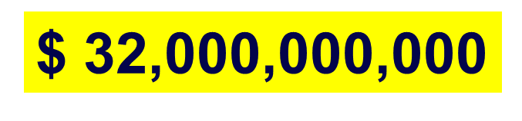
Heart Failure Health Care Cost a Year
2012 ?
$70,000,000,000
2030 ?

Slide 5

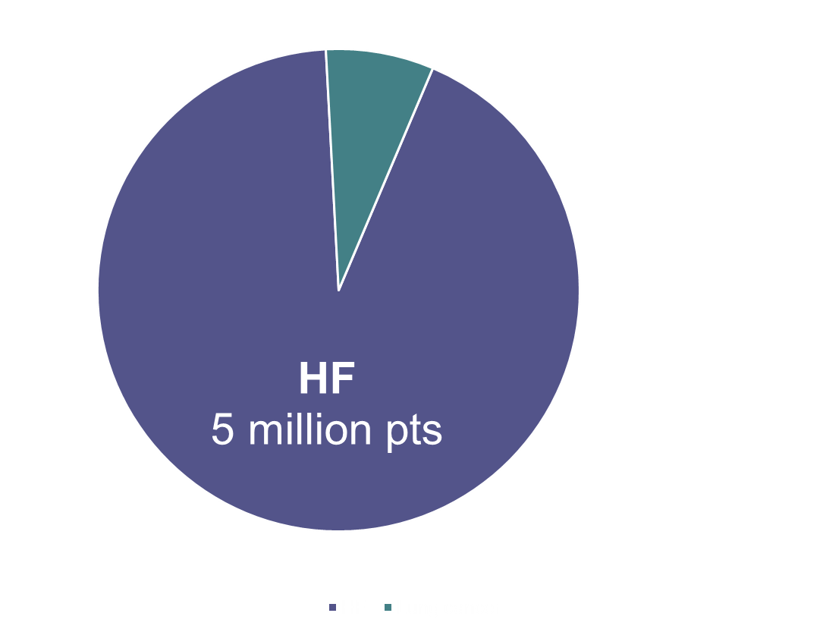
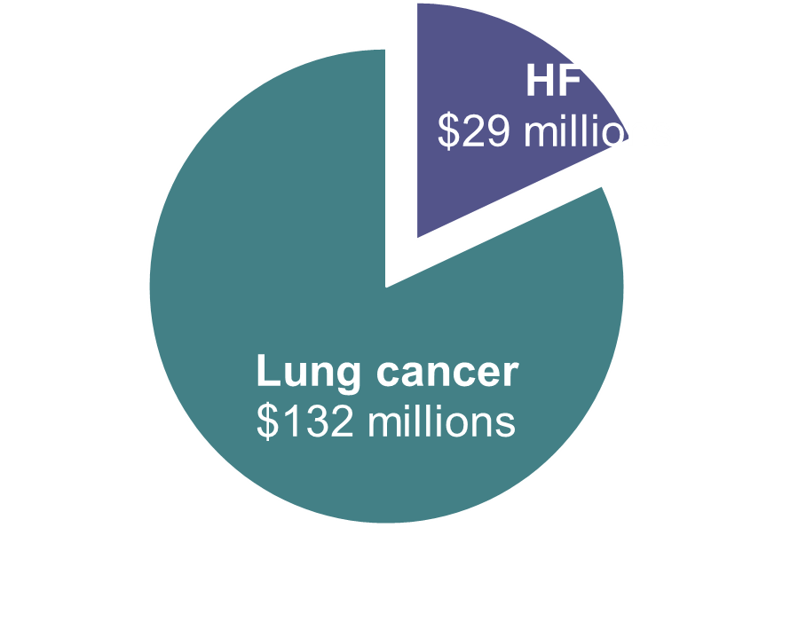

Heart Failure and Research Development
Lung Cancer
390,000 patients
AHA.org

Slide 6
Understand Heart Failure
ACC/AHA
RISK FACTORS
HTN
Diabetes
Obesity
Smoking
STAGE A
STAGE B
Structural Disorder
of the Heart
No symptoms of HF
STAGE C
Symptoms Associated W/
Structural Heart Disease
STAGE D
Severe Symptoms

Slide 7





Understand Heart Failure
NYHA Class I
NYHA Class II
NYHA Class III
NYHA Class IV

Slide 8
Drugs That Reduce Mortality in Heart Failure With Reduced Ejection Fraction
ACE
inhibitor
ARB
BB
MRA
ENTRESTO+BB+MRA
0%
63%
10%
20%
% Decrease in Mortality
30%
40%
60%
Based on results of SOLVD-Treatment, CHARM-Alternative,
COPERNICUS, MERIT-HF, CIBIS II, RALES and EMPHASIS-HF

Slide 9











100 HF patients

Slide 10
63 HF patients

Slide 11
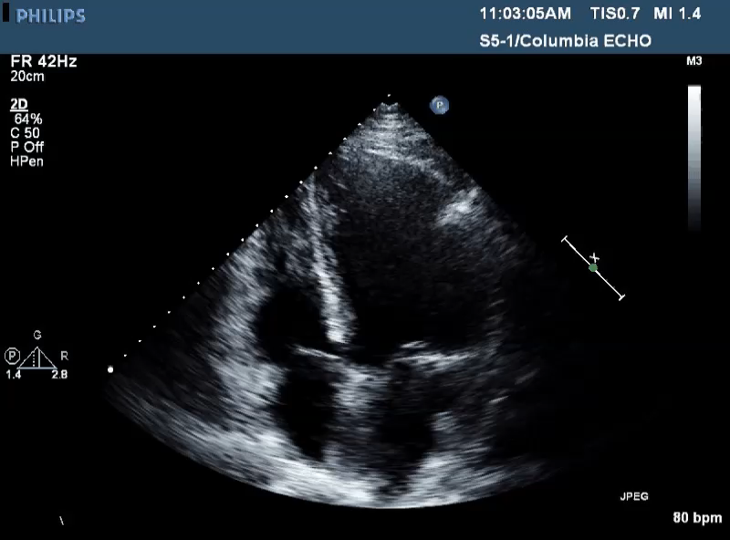
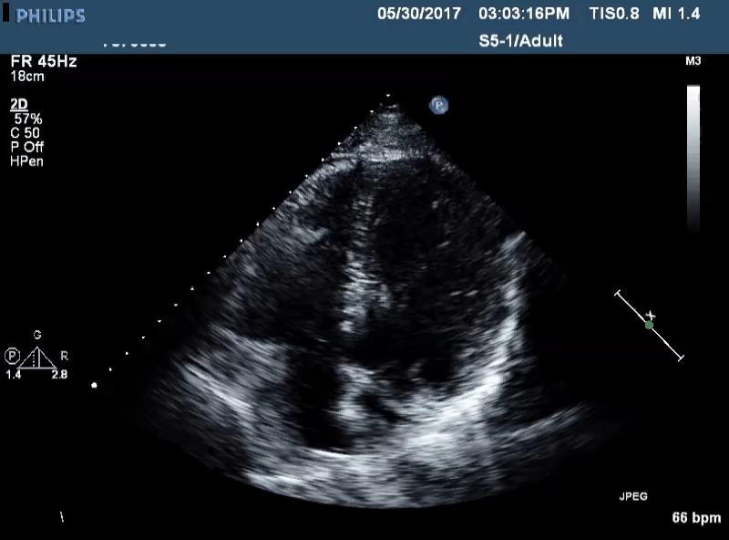

57yo Male
July, 2016
May, 2017
EF 20%
EF 50%

Slide 12
Understand Heart Failure
NYHA Class I
NYHA Class II
NYHA Class III
Advanced Heart Failure
NYHA Class IV

Slide 13
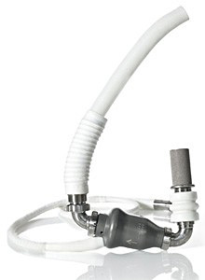

Advanced Heart Failure-STAGE D
Heart Transplant
250,000
Mechanical Support
2,819
3,000

Slide 14
#1 Understand Heart Failure
#2 Identify Your Needs
#3 Explore Treatment Options

Slide 15

Define Advanced Heart Failure
Frequent Admissions to The Hospital
Tired Most of The Time
My Blood Pressure is Too Low, Can not Take Meds
I can’t walk ( <300m)
Ouch, My ICD Fired
My Legs are always swollen
REFERRAL TO HEART FAILURE CENTER

Slide 16

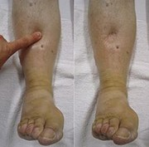


Legs swell up
Constantly Tired
Nagging cough
Bloated

Slide 17
#1 Understand Heart Failure
#2 Identify Your Needs
#3 Explore Treatment Options

Slide 18
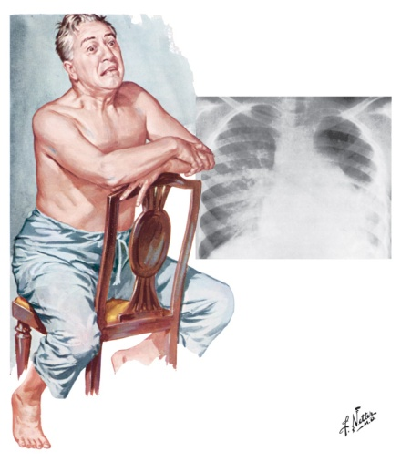
Options in Advanced Heart Failure
TRANSPLANT
CHF
LVAD
PALLIATION

Slide 19
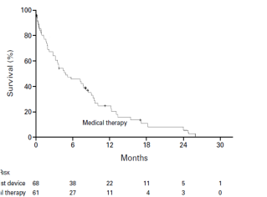
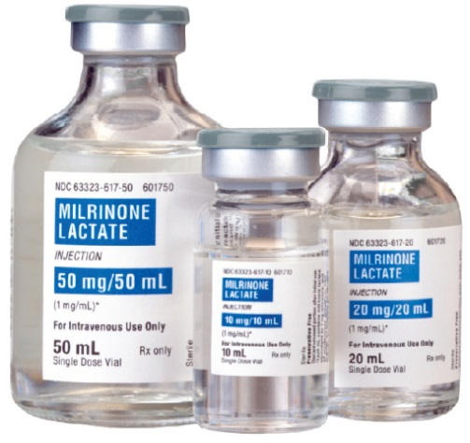
Options in Advanced Heart Failure-Palliation
25%
8%
Rose EA NEJM 2001;345:1435

Slide 20
Options in Advanced Heart Failure
TRANSPLANT
CHF
LVAD
PALLIATION

Slide 21
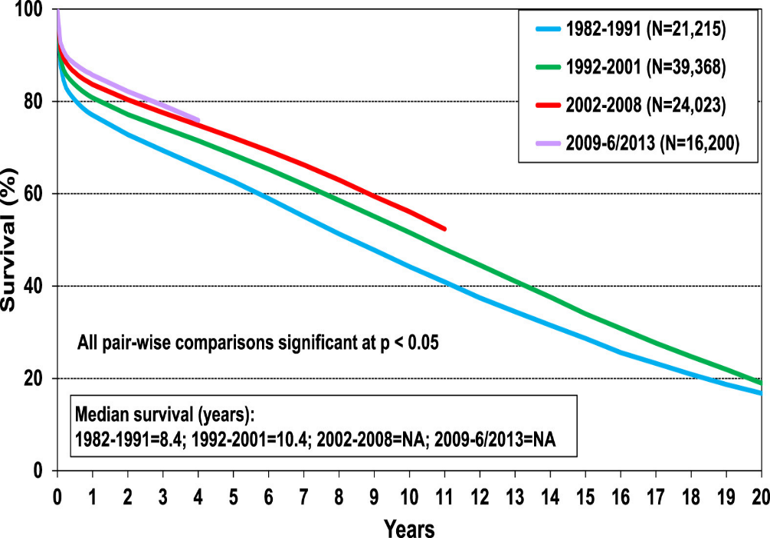
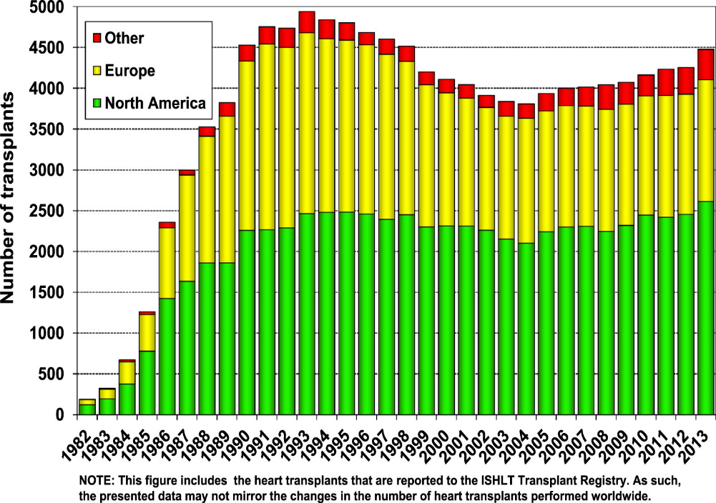
Options in Advanced Heart Failure-Transplantation
1-year survival of 88%
Median Survival of 11 years
13 years after 1 year
Lund LH J Heart Lung Transplant 2015;34:1244

Slide 22

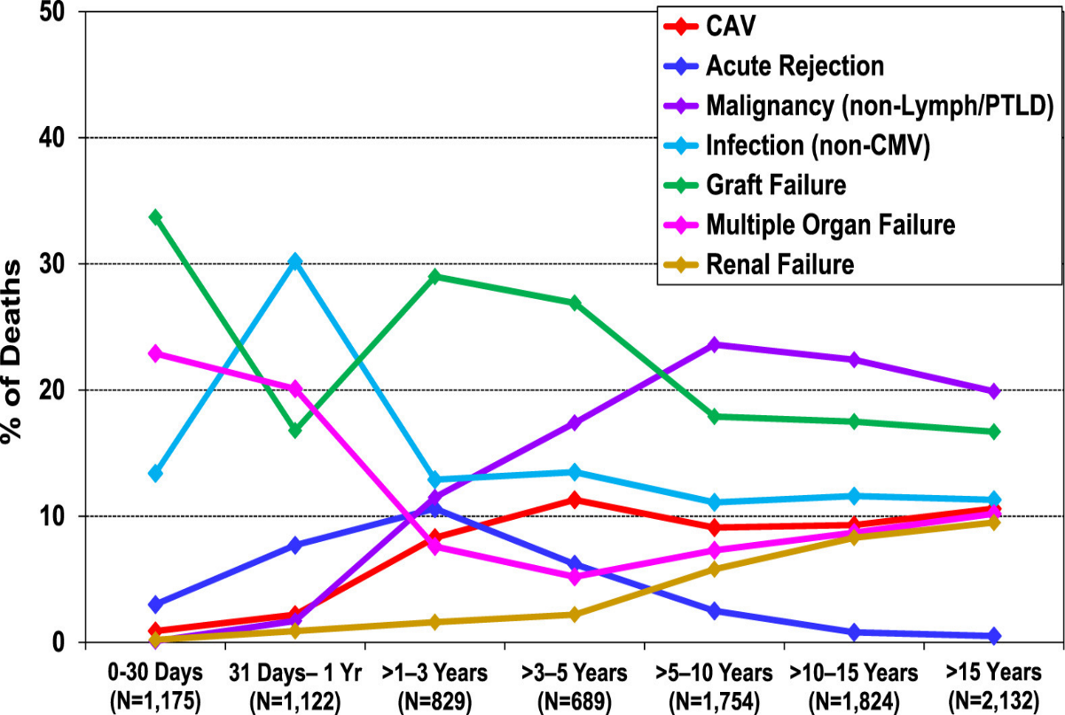
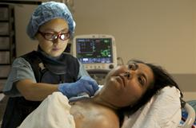
Options in Advanced Heart Failure-Transplantation
Life -Long
Immunosuppression
Frequent Heart Biopsy
Lund LH J Heart Lung Transplant 2015;34:1244

Slide 23
Options in Advanced Heart Failure
TRANSPLANT
CHF
LVAD
PALLIATION

Slide 24
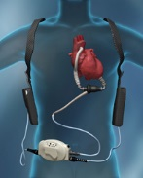
WHAT’S AN LVAD?
The left ventricular assist device, LVAD or VAD,
is a mechanical heart pump. It's placed inside a person's chest, where it helps the heart pump oxygen-rich blood throughout the body.
Unlike an artificial heart, the LVAD doesn't replace the heart. It just helps it do its job.
GOOGLE.COM

Slide 25

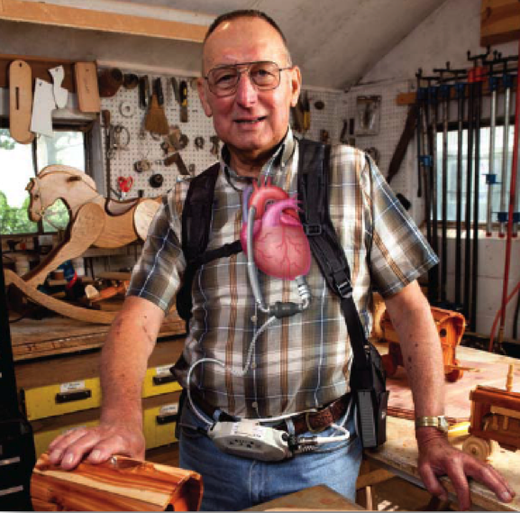
PUMP
BATTERIES
CONTROLLER

Slide 26
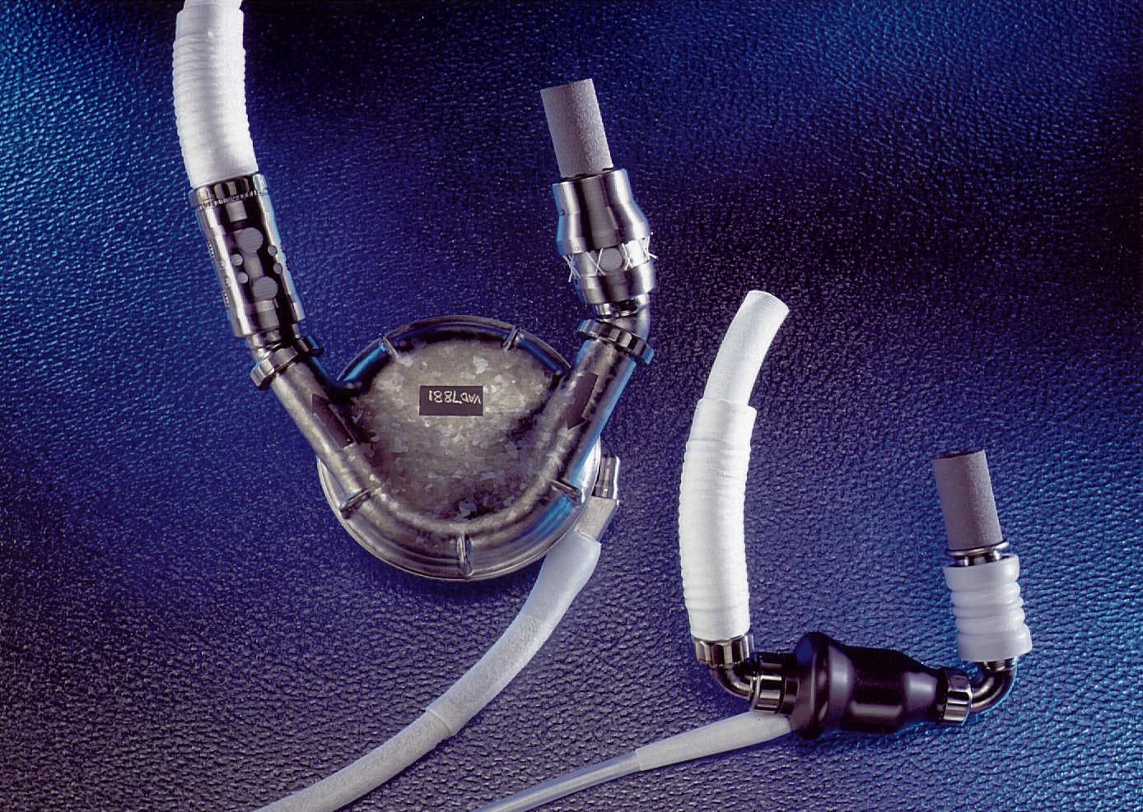

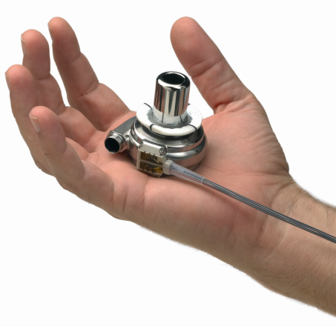
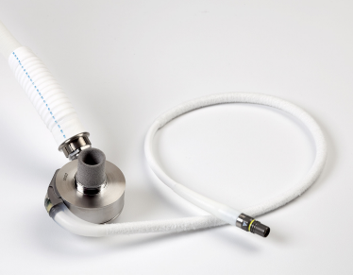
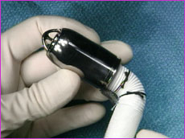
Evolution
Pulsatile Flow
Continous Flow
Axial
Continous Flow
Centrifugal
HeartMate I
HeartMate II
145g
1,180g
320g
HVAD
HeartWare
HeartMate 3
200g
90g
Jarvik 2000
Notes:
Write down grams smaller lighter

Slide 27
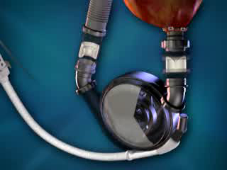

HEARTMATE I

Slide 28
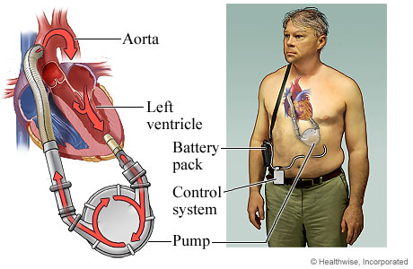
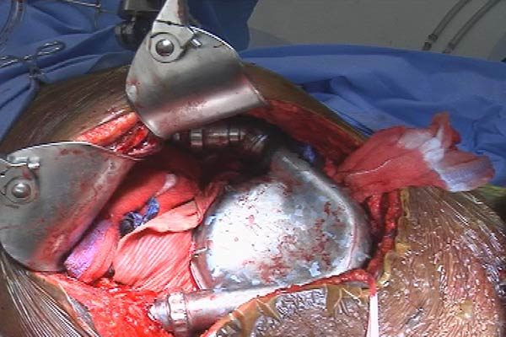
LVAD-HEARTMATE I
NO LONGER PRODUCED

Slide 29
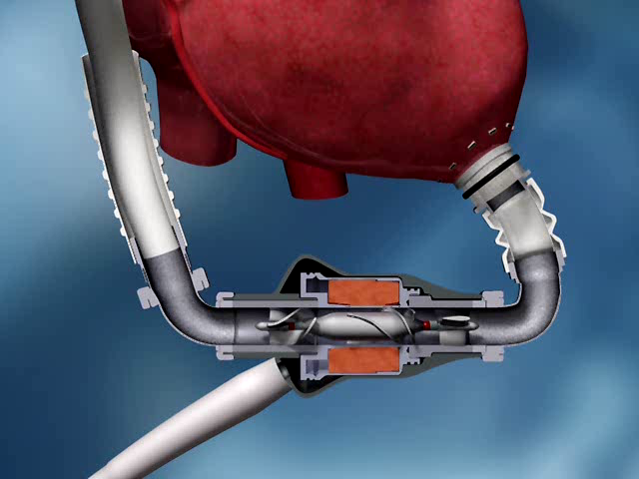

LVAD
HEARTMATE II
Notes:
una turbina assiale risucchia il sangue dal ventricolo sinitro e’ lo eietta in un condotto in uscita che si collega con l’aorta ascendente

Slide 30
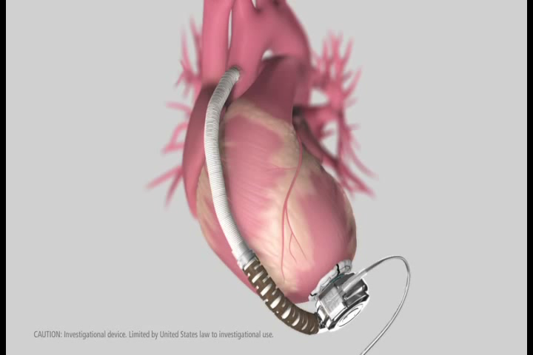
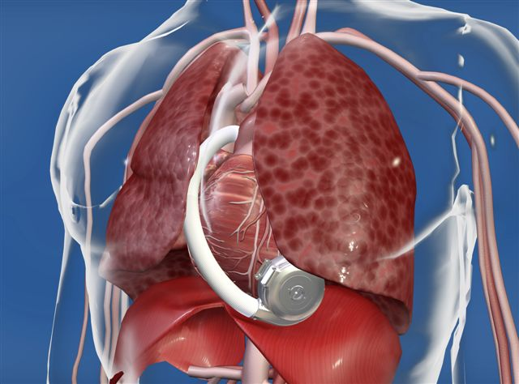
LVAD
HEARTWARE

Slide 31
Options in Advanced Heart Failure
TRANSPLANT
LVAD-BTT
CHF
LVAD
LVAD-DT
PALLIATION

Slide 32


HMII Post-Approval
Study Outcomes
LVAD-BTT
Heart Ware
ADVANCE Trial
92.0% Transplant or Alive
62.8% Alive
Proportion of Patients
29.2% Transplant
4.4% Device Exchange
3.6% Death
Results are Excellent!!!
6-month success > 90% -- 12-month success > 85%
Jorde UP J Am Coll Cardiol 2014;63:1751
Aaronson KD Circulation 2012;125:3191
Notes:
HeartMate II:
BTT-2008, DT- 2010
Heartware:
BTT- 2012

Slide 33
LVAD-DT---HeartMate II
100
88%
Heart Transplant
90
84%
80
74%
CAP trial (N=281)
70
61%
60
Average Support Duration
Percent Survival
PIVOTAL trial (N=133)
50
Early trial = 2.0 ± 1.6 years (longest: 5.5 years)
Mid trial = 1.5 ± 1.0 years (longest: 3.4 years)
40
P(log-rank) = 0.134
30
P(adjusted for BSA) = 0.162
OMM
20
At Risk:
10
281
215
188
167
94
0
133
95
82
69
62
8%
0
6
12
18
24
Time (Months)
Jorde UP et al JACC 2014;63:1751–1757
Notes:
DT survival at 1 and 2 years was 82±5% and 69±6% for INTERMACS profiles 4-7
72±3% and 60±4% for INTERMACS 1-3 (n=184).

Slide 34
LVAD Complications
Bleeding
Clotting
Stroke
Infection
Right Sided Heart Failure
Pump Failure

Slide 35
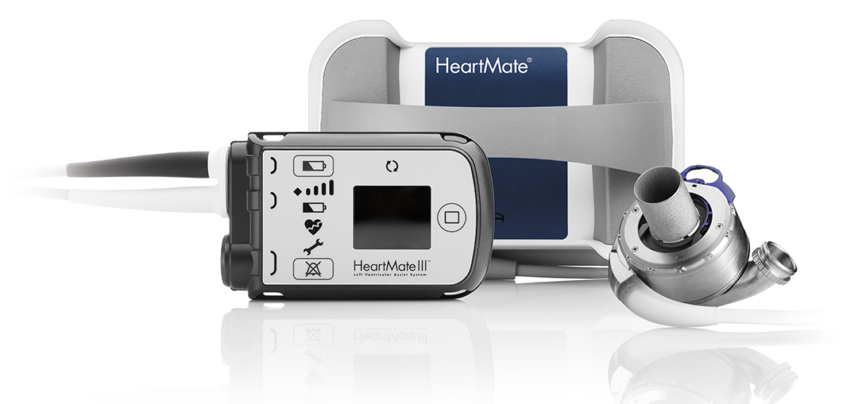
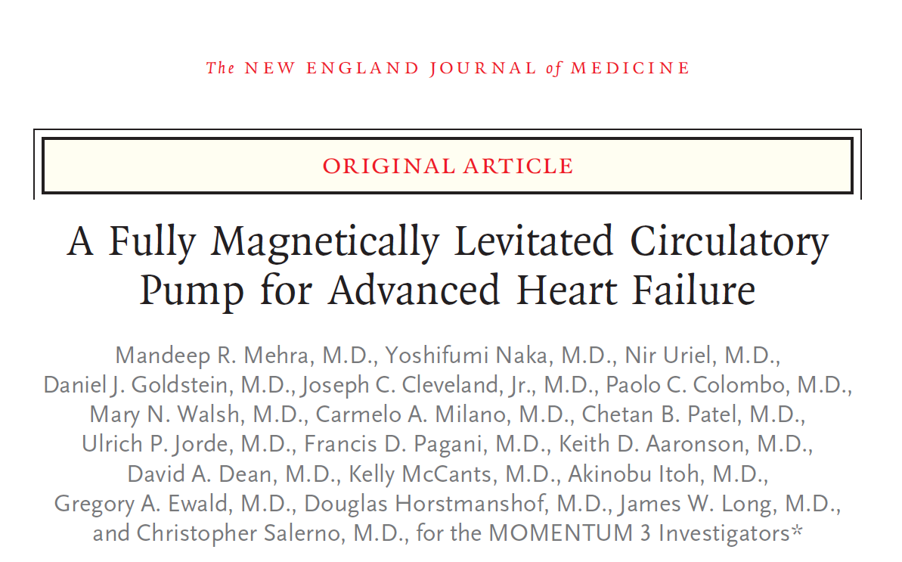
LVAD-HEARTMATE 3

Slide 36
LVAD-HEARTMATE 3
  Survival at 6 months free of disabling stroke or reoperation to replace or remove the pump (ITT)
HeartMate 3
86%
HeartMate II
77%
NO BLOOD CLOTS
¹Mehra MR, Naka Y N Engl J Med. 2017 Feb 2;376(5):440-450

Slide 37
“If you had it all to do over again would you decide
to have an LVAD knowing what you know now?”
L.W. Stevenson et al. ISHLT 2017

Slide 38
#1 Understand Heart Failure
#2 Identify Your Needs
#3 Explore Treatment Options

